Slide 1








File System Extension
/
Places
Recent
Home
Desktop
Documents
Downloads
Music
Pictures
Videos
Trash
Devices
Computer
Network
Connect to Server
work
private
04.04.2024
Anna Pietzak, Timothy Roberts
Operating Systems FS24

Slide 2


/File System Extension/Problem.txt
Places
Recent
Home
Desktop
Documents
Downloads
Music
Pictures
Videos
Trash
Devices
Computer
Network
Connect to Server
We have only one device for all parts of our live.
Holiday Pictures
CS Exercises
Work hours

Slide 3
/File System Extension/Solution.c
Places
Recent
Home
Desktop
Documents
Downloads
Music
Pictures
Videos
Trash
Devices
Computer
Network
Connect to Server
Name
Date
Type
Tag
Holiday Pictures
30.12.2023
folder
private
CS Exercises
01.04.2024
folder
education
Work hours
27.03.2024
folder
work
We can extend our file system to allow for further categorisation of our files.
That way we can selectivly display only files related to our current activity.

Slide 4
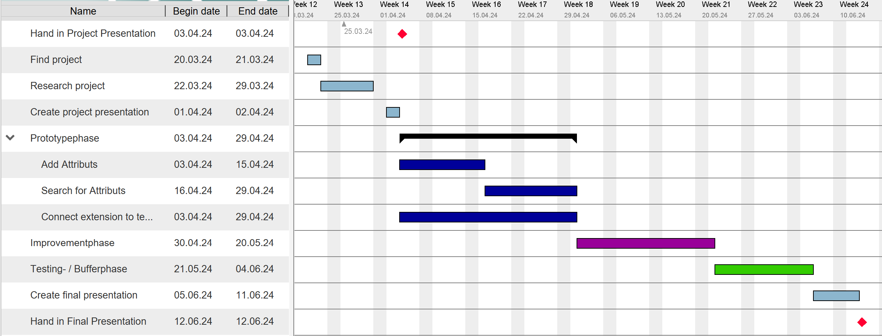
/File System Extension/Time Table.png
Places
Recent
Home
Desktop
Documents
Downloads
Music
Pictures
Videos
Trash
Devices
Computer
Network
Connect to Server
A
T

